Slide 1
Data Streaming and IoT
Using Pivotal Big Data Suite
Fred Melo
fmelo@pivotal.io
@fredmelo_br

Slide 2
The Journey to the Data-Driven Enterprise
Data Science and Machine Learning
Converging Trends
Internet
of Things
Big Data
Innovation
New Data
New Processes
New Insights

Slide 3


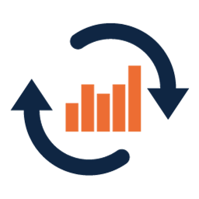
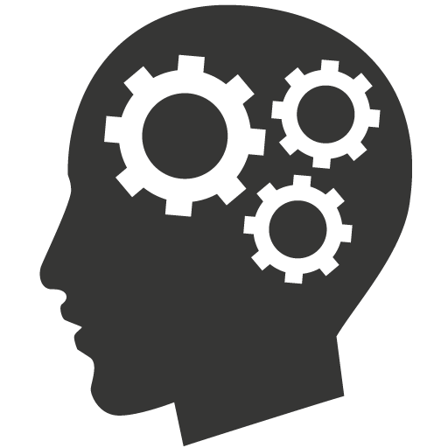




Migrating from a Reactive, Static and Constrained Model…
Ingest
Store
Analytics
Data Lake
HDFS
Coding based
No real-time information
Based on expensive ETL
Hard to change
Labor intensive
Inefficient

Slide 4
To Pro-Active, Self-Improving, Machine Learning Systems
Data Stream Pipeline
In-Memory Real-Time Data
HDFS
Expert System / Machine Learning
Data Lake
Multiple Data Sources
Real-Time Processing
Store Everything
Continuous Learning
Continuous Improvement
Continuous Adapting

Slide 5
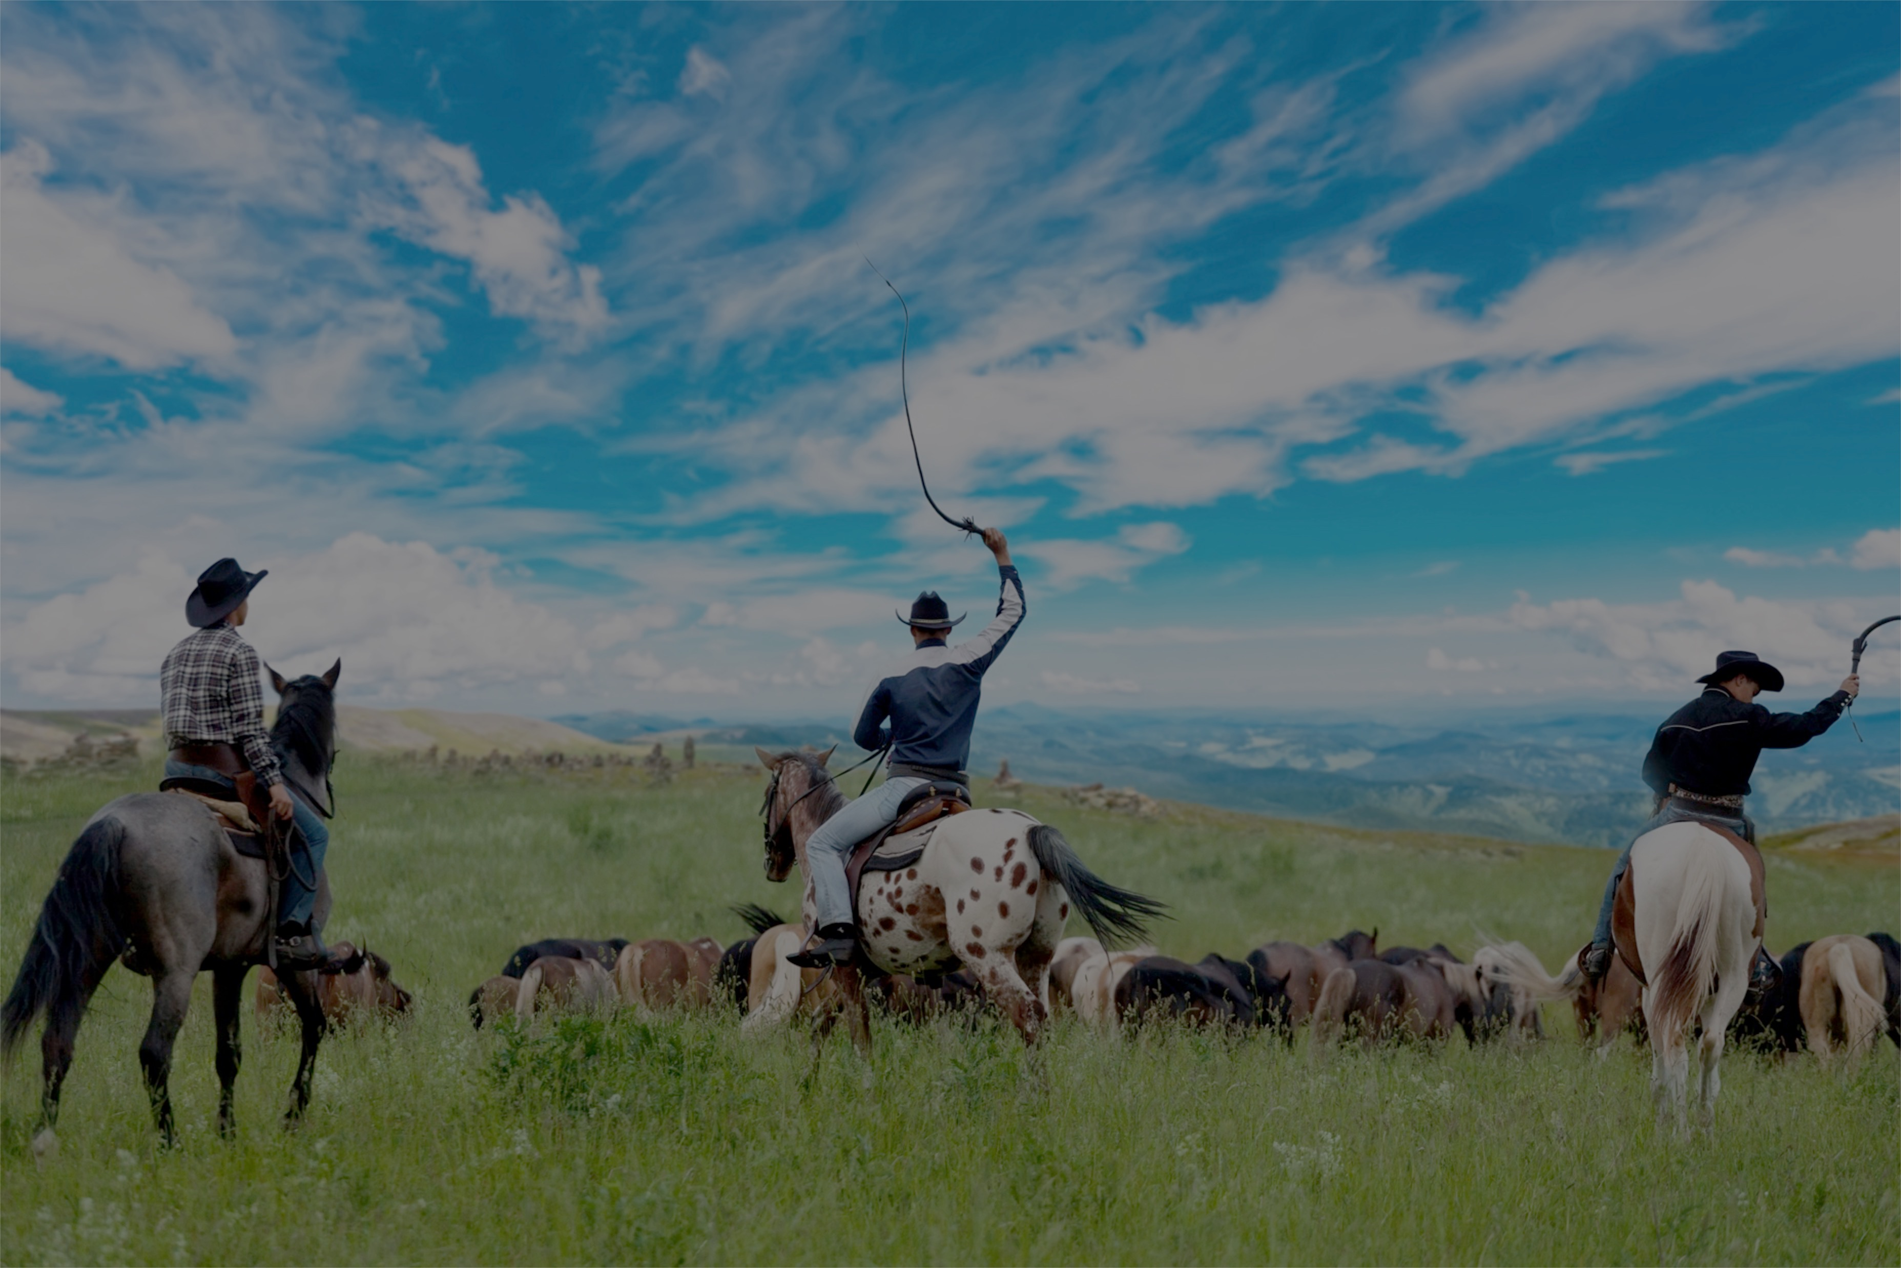
“
50-80% OF THE TIME ON DATA SCIENCE PROJECTS IS SPENT ON DATA WRANGLING
”
New York Times Research: http://www.nytimes.com/2014/08/18/technology/for-big-data-scientists-hurdle-to-insights-is-janitor-work.html

Slide 6





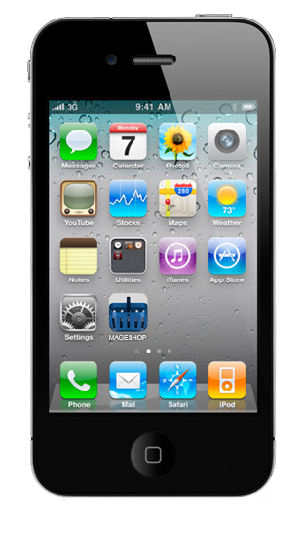

Still…
Data Feeds
Historical Data
Stream Processing
Expert Systems Machine Learning
Data Lake
HDFS
Business Value
Smart Decisions

Slide 7




Data Stream Needs an Agile, Scalable and Fast Solution
Ingest
Transform
Sink
GemFire
SpringXD
Data
Lake
HAWQ
GPDB

Slide 8
Spring XD Orchestrates and Automates all the Steps on Data Stream Pipelining
Distributed
Computing
In-Memory Real-Time Data
Ingest
Transform
Sink
SpringXD
Extensible
Open-Source
Fault-Tolerant
Horizontally Scalable
Expert System /
Machine Learning
Data
Lake
HAWQ
GPDB

Slide 9
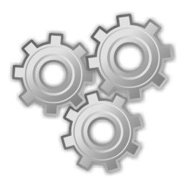

Spring XD
State of the Art Data Pipeline Automation
Ingest / SINK
Process
Analyze
No coding required
Dozens of built-in connectors
Seamless integration with Kafka, Sqoop
Create new connectors easily using Spring
Call Spark, Reactor or RxJava
Built-in configurable filtering, splitting and transformation
Out-of-box configurable jobs for batch processing
Import and invoke PMML jobs easily
Call Python, R, Madlib and other tools
Built-in configurable counters and gauges

Slide 10
GemFire Provides Scalable, Low-Latency Data Access, Storage and Event Processing
Distributed
Computing
Ingest
Transform
Sink
GemFire
SpringXD
Extensible
Open-Source
Fault-Tolerant
Horizontally Scalable
Expert System /
Machine Learning
Data
Lake
HAWQ
GPDB

Slide 11
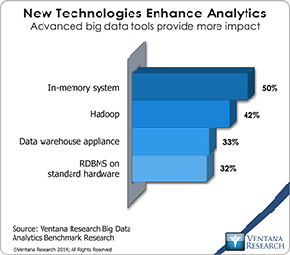
GemFire
In-memory Real Time Data
In-Memory Enterprise Data Grid
Horizontally Scalable, Consistent, Highly Available
Event handling
Continuous Queries
Enterprise Data Geo Distribution

Slide 12
Pivotal Provides SQL Based Advanced Analytics
Distributed
Computing
Ingest
Transform
Sink
GemFire
SpringXD
Extensible
Open-Source
Fault-Tolerant
Horizontally Scalable
Expert System /
Machine Learning
Data
Lake
HAWQ
GPDB

Slide 13
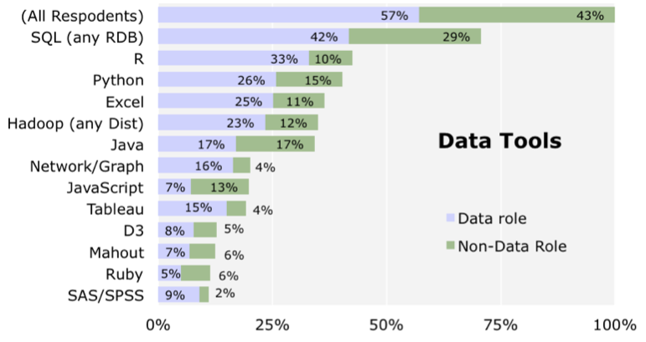
HAWQ
Advanced SQL analytics in Hadoop
Massively Parallel Processing RDBMS on HADOOP
ANSI SQL on Hadoop
Extremely high performance for analytics (not like Hive)
Stores all data directly on HDFS
Open-Source
SQL remains #1 choice for Data Science
Combining SQL with Hadoop is key for analytics

Slide 14
Developers and Data Scientists Can Focus on the Business Value of Data
Ingest
Transform
Sink
GemFire
SpringXD
Extensible
Open-Source
Fault-Tolerant
Horizontally Scalable
Data
Lake
HAWQ
GPDB

Slide 15



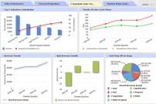





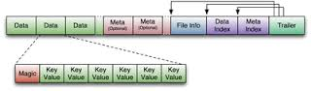
Data Streaming Reference Architecture
Data Feeds
Transactional Apps
Analytic Apps
Data Stream Pipeline
Distributed
Computing
Real-Time Data
Expert Systems & Machine Learning
Advanced
Analytics
Data Lake
HDFS

Slide 16
Data Streaming Reference Architecture
Data Feeds
Transactional Apps
Analytic Apps
Data Stream Pipeline
SpringXD
GemFire
HAWQ
GPDB
Data Lake
HDFS

Slide 17

“
SO WE ARE MOVING TO A WORLD WHERE THE MACHINES WE WORK WITH ARE NOT JUST INTELLIGENT; THEY ARE BRILLIANT.THEY ARE SELF-AWARE, THEY ARE PREDICTIVE, REACTIVE AND SOCIAL. IT'S A WORLD WHERE INFORMATION ITSELF BECOMES INTELLIGENT AND COMES TO US AUTOMATICALLY WHEN WE NEED IT WITHOUT HAVING TO LOOK FOR IT.
”
MARCO ANNUNZIATA, GE

Slide 18







The IoT Market Verticals
Diversified Industrial Manufacturers
Agriculture, Security, Retail
Auto Manufacturers
Media (via Mobile devices)
Urban Infrastructure, Cities
Consumer, Connected Home etc.
Healthcare, Life Sciences

Slide 19

“
THE MAGIC HAPPENS WHEN YOU MARRY THE TRADITIONAL ENGINEERING APPROACH WITH THE DATA SCIENCE ENABLED BY THE DATA LAKE. IT OPENS UP A WHOLE NEW WORLD OF POSSIBLE ‘WHAT IF’ QUESTIONS.
”
DAVE BARTLETT, GE AVIATION

Slide 20
GE Aviation – Big Data & IoT
Goal
Improve jet engine efficiency and increase service profitability
Unable to store & analyze massive amounts of data for analytics
Solution
LARGE DATA SETS ingested via batch
Store 100s TB of engine data in Hadoop (PHD)
Open doors for industrial engineers to poke at data (HAWQ)
FAST MACHINE LEARNING based algorithms
2000x faster, 10x cheaper
Customer portals for visibility

Slide 21

“
THE REAL OPPORTUNITY FOR CHANGE...SURPASSING THE MAGNITUDE OF THE CONSUMER INTERNET...IS THE INDUSTRIAL INTERNET, AN OPEN, GLOBAL NETWORK THAT CONNECTS PEOPLE, DATA AND MACHINES.
”
JEFF IMMELT, CEO, GE

Slide 22
GE Energy – Fast Data & IoT
Goal
Failing gas turbines causing issues with power generation
Unable to store & process fire-hose of data
Solution
HIGH VELOCITY data ingestion from Gas Turbines
Store 10 TB of turbine data in memory (GemFire)
VERY LOW LATENCY and HIGH SPEED data access
“Predictive” Maintenance

Slide 23

“
… YOU USE THOSE DEVICES TO INSPECT CARS AND KEEP TRACK OF INSPECTION RECORDS. THAT CAN THEN FLOW INTO ASSET MANAGEMENT SOFTWARE TO PROVIDE PREDICTIVE ANALYSIS OF WHEN THE ASSET NEEDS TO BE MAINTAINED ... WHEN YOU BOIL THAT DOWN TO BUSINESS, IT’S ABOUT COMPETITIVE ADVANTAGE.
”
BRAD HOWELL, LODESTAR LOGISTICS

Slide 24
GE Transportation – Big & Fast Data
Goal
Help rail companies manage locomotives better
Fast data from tracks & Big data from sensors in locomotives
Solutions
MACHINE LEARNING MODEL built from combined data set (MADLib)
REAL TIME SCORING of rail sensor data (Spring XD)
REAL-TIME ALERTING of critical events via email & a REAL TIME DASHBOARD (Spring)

Slide 25
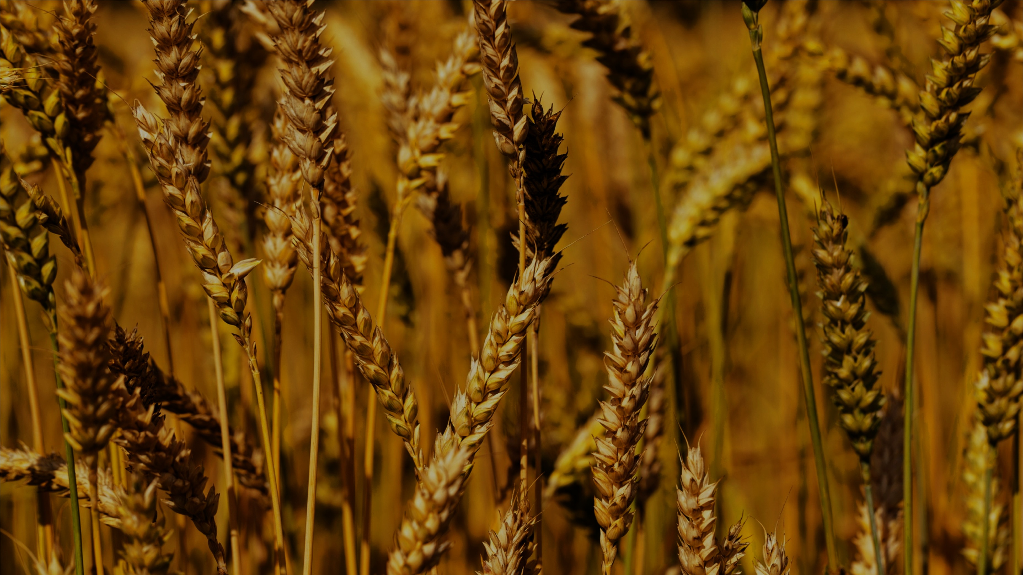
“
WE EXPECT THE PRECISION AGRICULTURE SPACE TO CONTINUE TO GROW QUICKLY AS DATA BECOMES CHEAPER TO STORE AND EASIER TO MOVE FROM PLATFORM TO PLATFORM. WE ARE JUST BEGINNING TO EXPLORE ALL THE VALUE WE CAN CREATE FOR FARMERS WITH THESE TOOLS.
”
BRETT BEGEMANN, MONSANTO

Slide 26
Monsanto – Agriculture & IoT
Goal
Help farmers maximize crop yields
Solution
Use of Big Data to collect & store data from farm equipment
Combine with climate and other information
Build custom apps using an agile app dev platform (PCF)

Slide 27



IoT - Need for a Platform
Pivotal Cloud Foundry
Pivotal Big Data Suite
A Better Customer Experience
Using Innovative Data-Driven Apps On a Integrated Platform

Slide 28





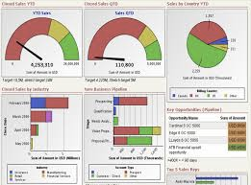
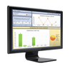
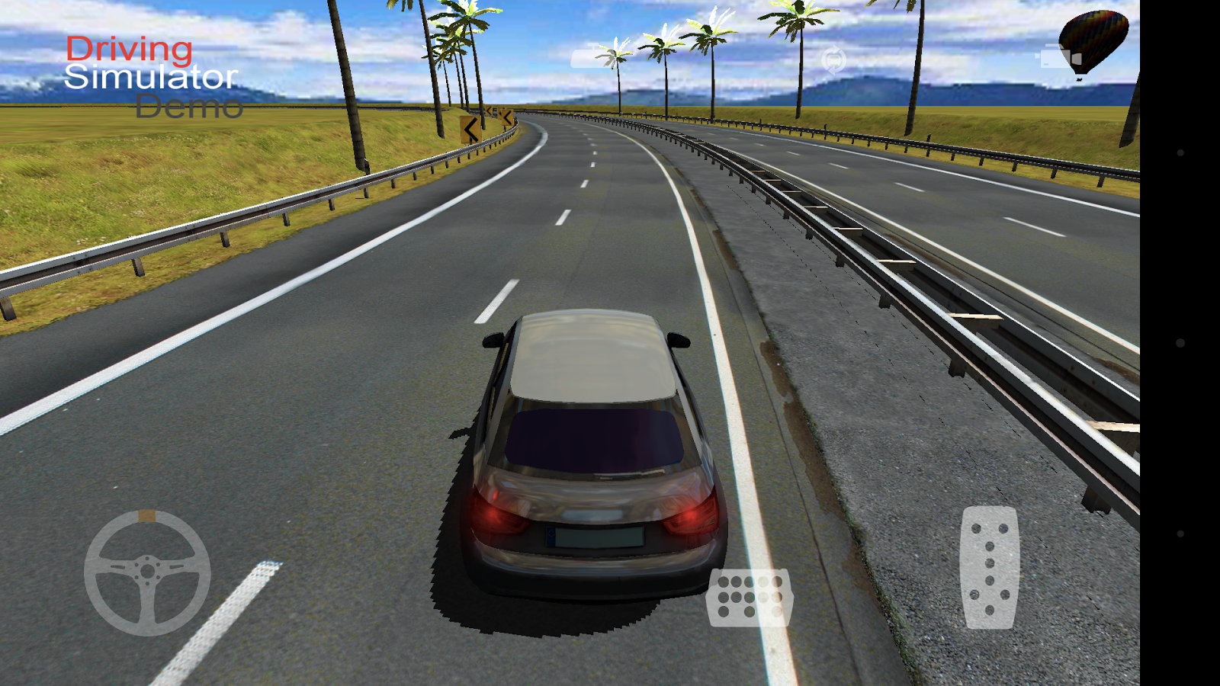
The Connected Car Architecture
Rabbit MQ
INGESTION
STREAM PROCESSING
DATA LAKE
JSON / HTTP
Enrich
Transform
Spring XD
Sink
Pivotal HD
MOBILE SERVICES
REAL-TIME DATA INSIGHTS
ADVANCED ANALYTICS
PUSH
GemFire
HAWQ
MICROSERVICES
IoT APPS
Pivotal CF
Dashboard
Analytics App
Simulator

Slide 29


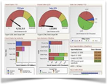
Rabbit MQ
MOBILE
APP
STREAM PROCESSING
+ Timestamp
& GUID
+ MPG, rangE
& route
JSON
Spring XD
Sink
DATA LAKE
Pivotal HD
Tap
ADVANCED ANALYTICS
ENRICHER
PREDICTIVE ANALYTICS
CAR
SENSOR
HAWQ
DASHBOARD
Horizontally Scalable
Fault Tolerant
Extensible
Open-Source
REAL-TIME DATA INSIGHTS
GemFire

